Slide 1
Real-Time Web Development
Chapter 2
The New Era of .NET Core

Slide 2
Chapter Overview
Introduction to .NET Core
Learn about the basic fundamentals of .NET and .NET Core
.NET Core primary features
.NET overall architecture
Introduction to ASP.NET Core
Learn about the basic fundamentals of ASP.NET Core
The differences between ASP.NET and ASP.NET Core
ASP.NET Core features
Versions and Roadmap of .NET Core and ASP.NET Core
Learn about the history of .NET Core and ASP.NET Core
Creating the Automobile Service Center Application
Create your own version of the Automobile Service Center Application using ASP.NET Core v1.1

Slide 3
Reading Activities
Introduction to .NET Core
Introduction to ASP.NET Core
Versions and Roadmap of .NET Core and ASP.NET Core
These sections should be read and understood, but do not worry about memorizing this material or studying it in depth. However, this is good information for understanding what .NET and ASP.NET is and how it has evolved over the years.

Slide 4
Programming activities
Creating the Automobile Service Center Application
In this section we will be creating our own web application from the beginning. This section goes over a lot of details that are also involved with using the command line for creation, building and running of an application. However, we will be focused primarily on the development within the Visual Studio 2019 IDE. Please note that when the book was written VS2017 was used, and will be referenced. Please do not get confused by this, and when this is mentioned, know that VS2019 is a newer version and can be used the same way. I have added screenshots for any menu that may look different than the one in the book.
The information presented in the book about the command line is, as before, good information but not necessary for understanding the fundamentals of web application development.

Slide 5
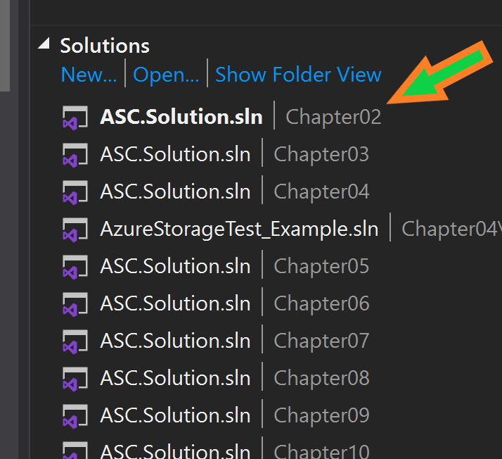
Programming activities
There is a solution for “Chapter 2” under the team explorer. This can be used to “assist” in seeing what should be done. There are also notes in the code files on any code changes that the book asks you to do for better understanding.
DO NOT! Copy and Paste from these, they are a reference tool only. You must do the work yourself if you are going to learn how to program web applications.

Slide 6
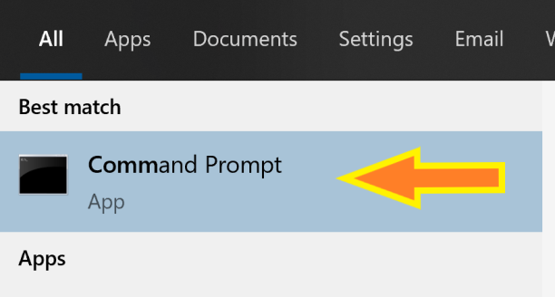

Checking the .NET Version on your development machine (computer)
Since we installed Visual Studio 2019 Community with the appropriate settings, this step is not necessary as we already know that the version of .NET on our development machines is up-to-date and ready to be used.
If you would like to do this, however, please run the “Command Prompt” from the Start menu.
Then run the following command from the console window:

Slide 7
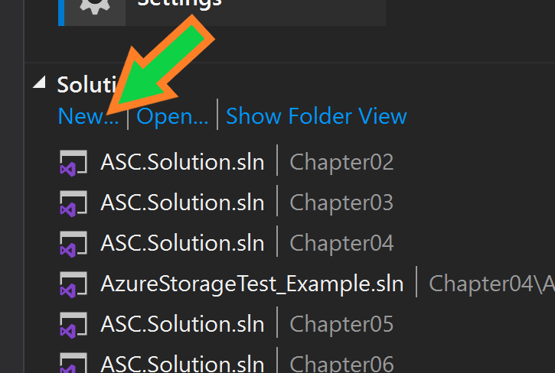
Creating the Web application
Due to our usage of a repository for use with this class, we will create this new project in the same repository as the chapter example solutions. Please follow the arrows for our project creation instead of the book.
Note that you will be working in your OWN branch for this, and NOT working in the master branch, so please confirm this before doing the following steps.
Create a new project in this repository from the Team Explorer Menu.
New Project Creation – Next Slide

Slide 8
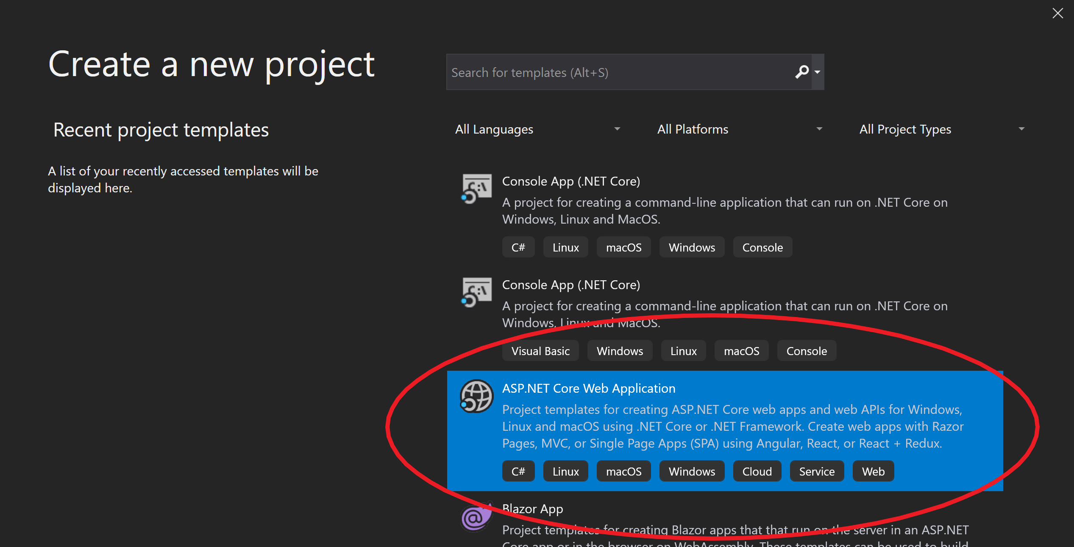
Creating the Web application
New Project Creation – Next Slide

Slide 9
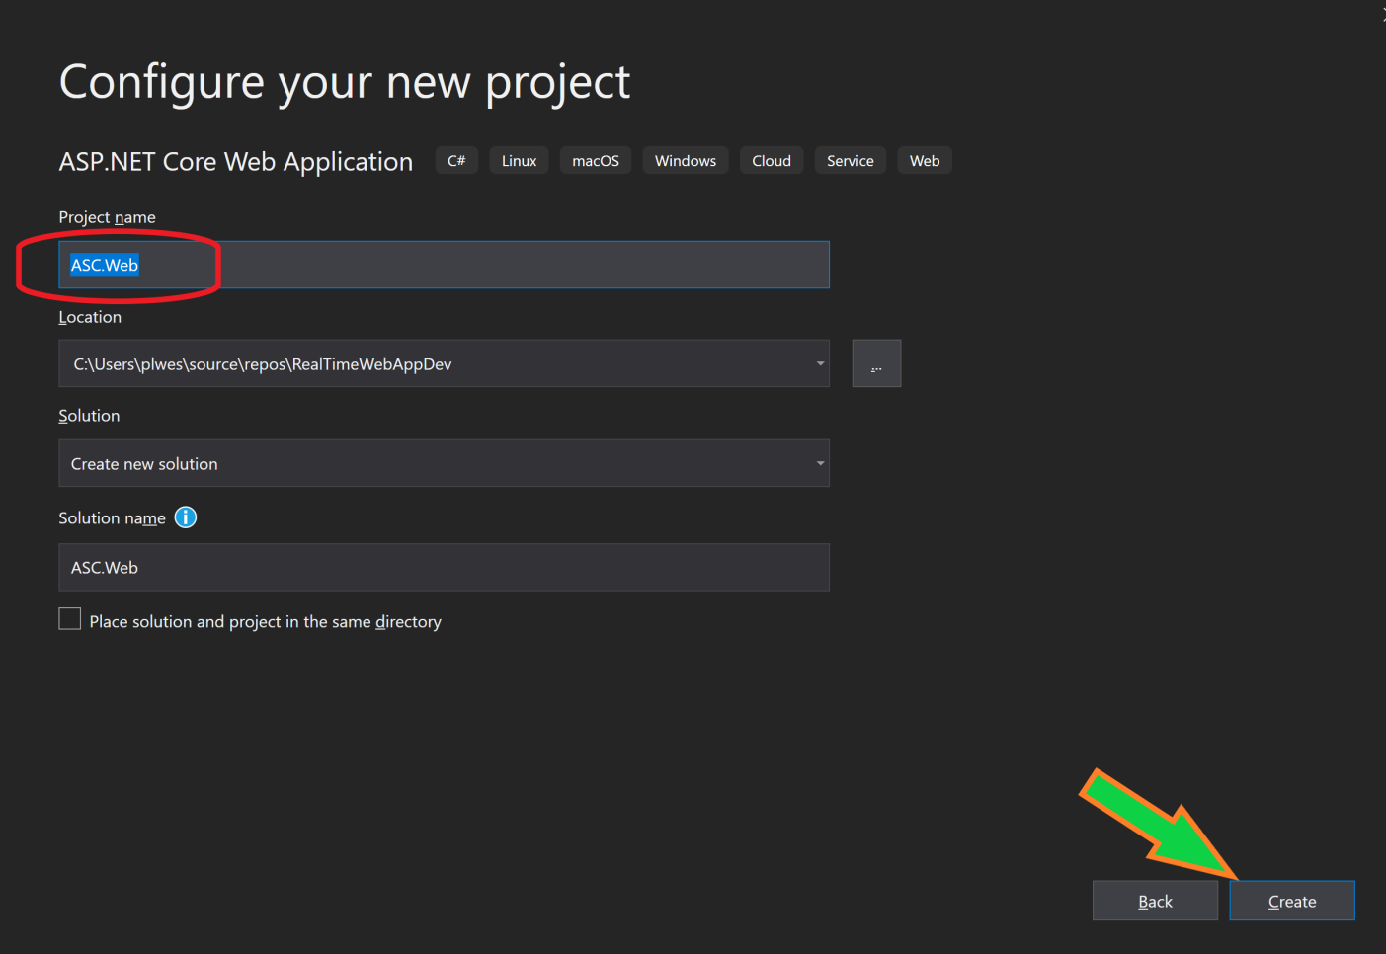
Creating the Web application
Name your new project “ASC.Web”
Select the “Create” button
New Project Creation – Next Slide

Slide 10
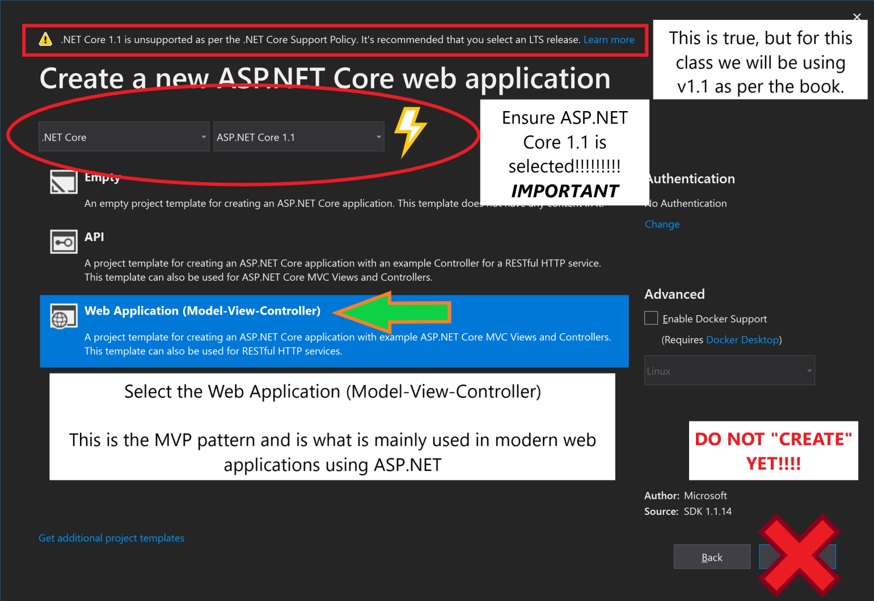
Creating the Web application
New Project Creation – Next Slide

Slide 11
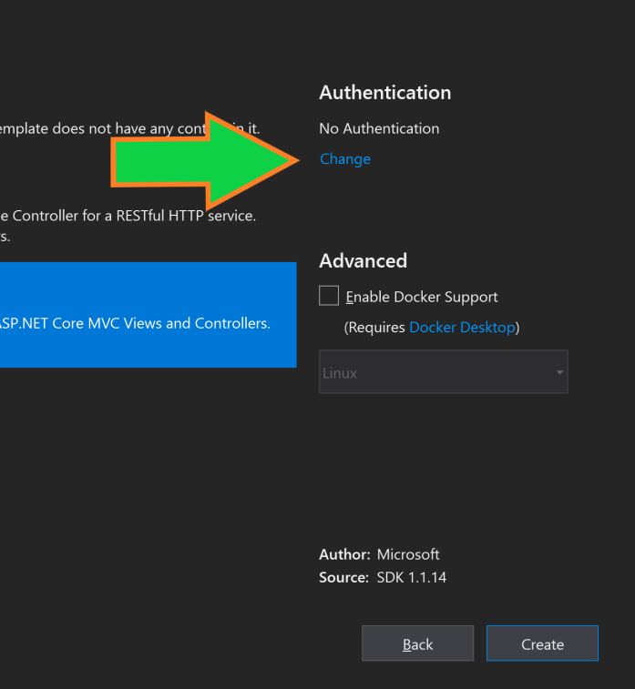
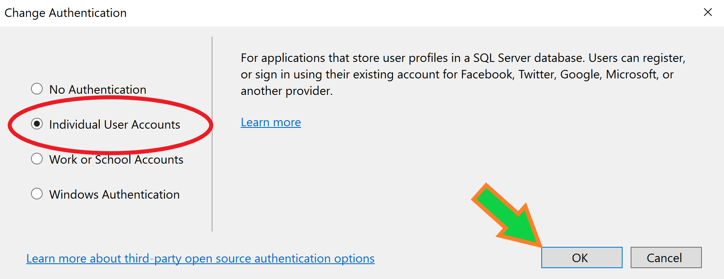
Creating the Web application
Custom Authentication
Select “Change”
Select “Individual User Accounts”
Select OK
New Project Creation – Next Slide

Slide 12
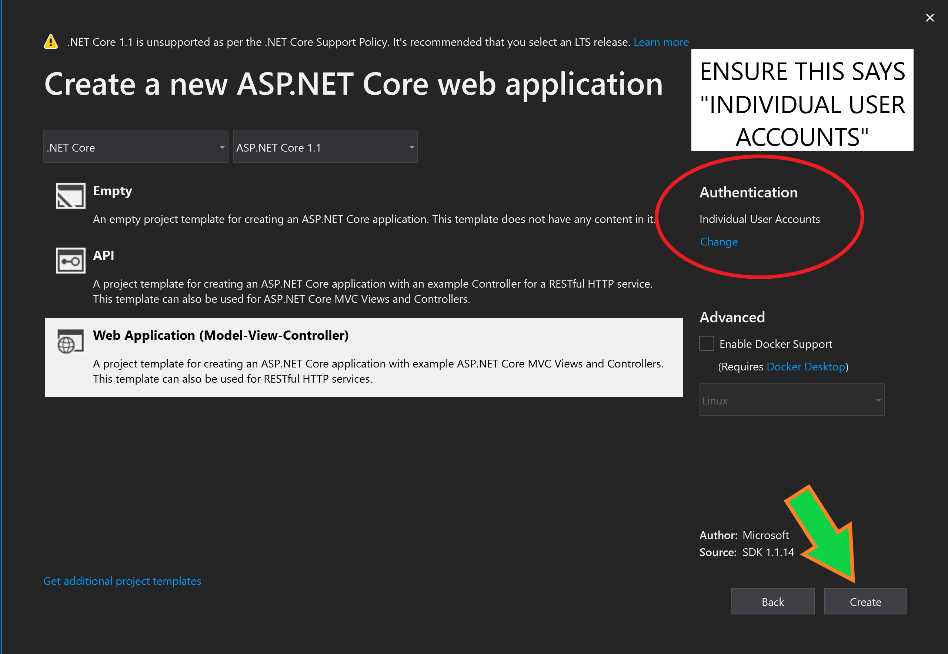
Creating the Web application
CREATE PROJECT!!!!!!!

Slide 13
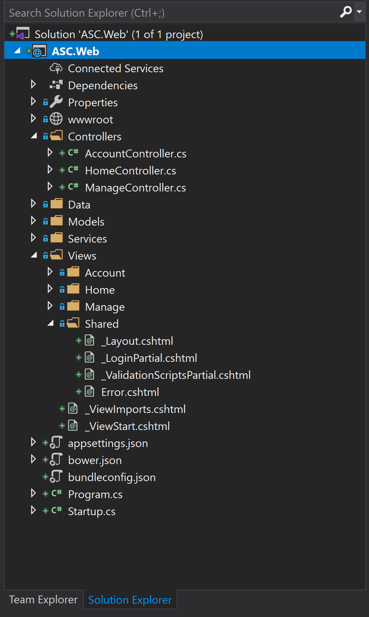
Initial application file structure
Ensure that the project has the following file structure in the solution explorer after creation.
If it does not, please contact me and I will help you get through this part of the process.

Slide 14
Setting Up the Application Configuration
During this section we will look at the using the appsettings.json and appsettings.{Environment}.json files for settings configuration for our web application.
This PowerPoint will guide you to know what folders and files that will be created and altered. It will NOT explicitly tell you exactly what to do, but will help you understand where these changes should be made. The instructions in the book can be vague at times, so this should help get past any confusion about files and how they are updated.
If you have trouble, please contact me with questions or concerns about this.
NOTE: IF YOU SEE A “RED SQUIGGLY LINE”, hover your mouse over the line and READ what it says. It will usually help you understand what is wrong with your code.

Slide 15
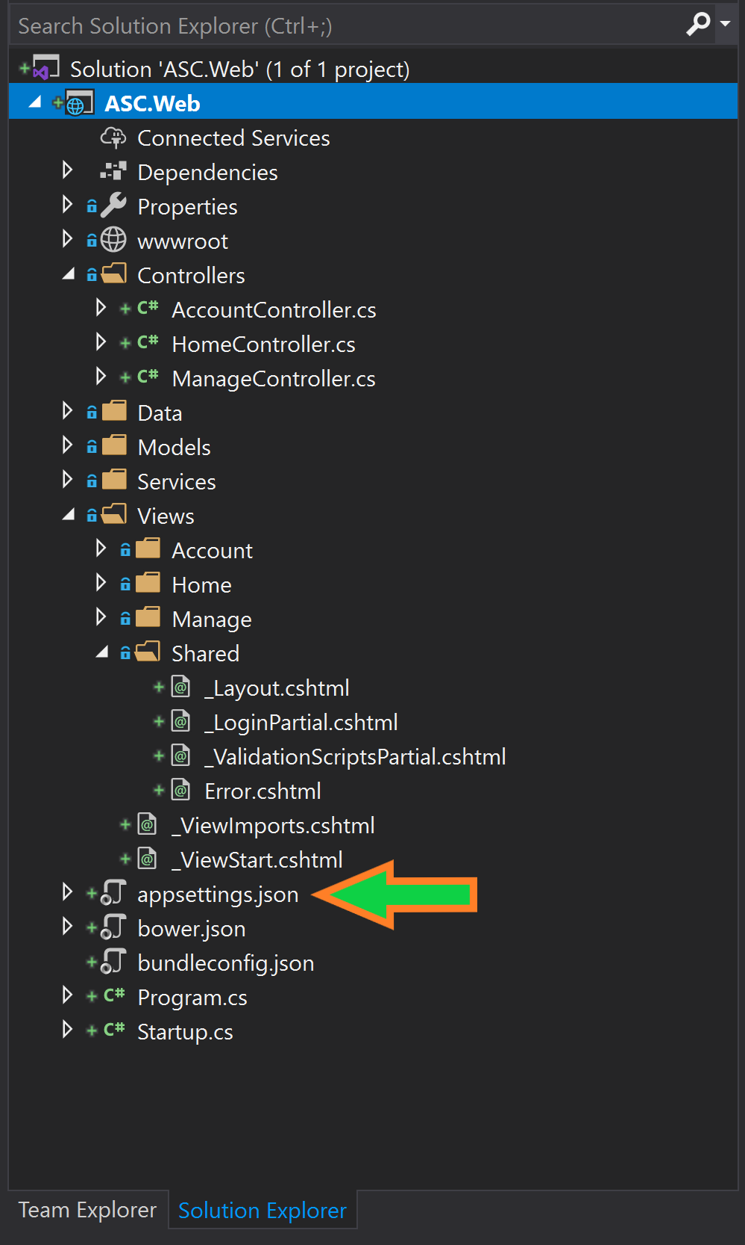
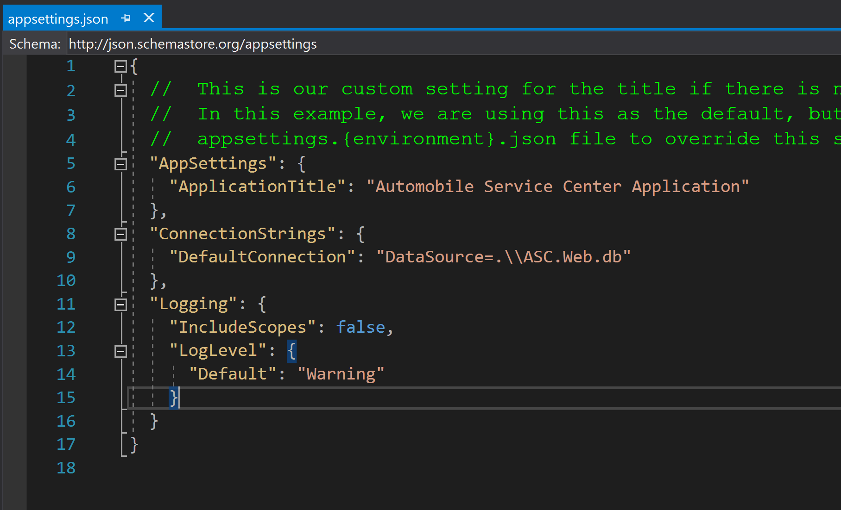
Appsettings.json
Listing 2.2:

Slide 16
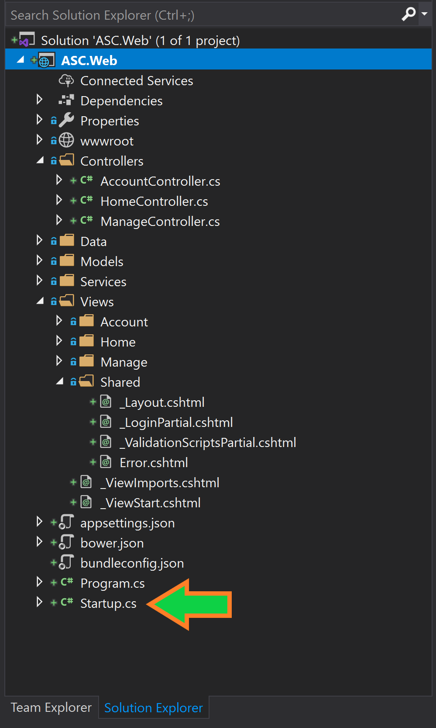
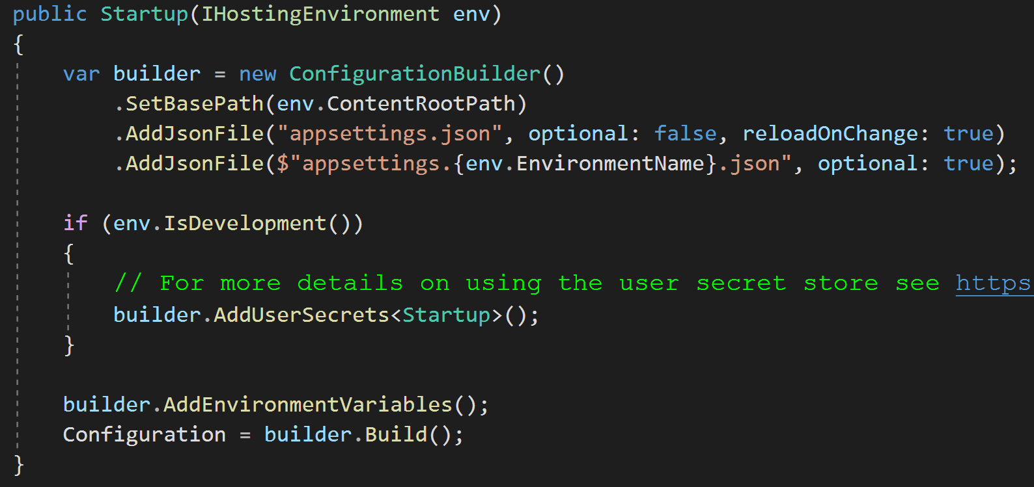
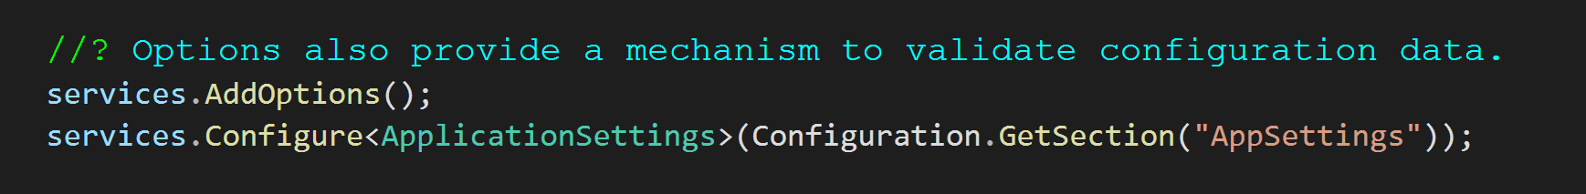
Startup.cs
Listing 2.3:
Listing 2.5:

Slide 17
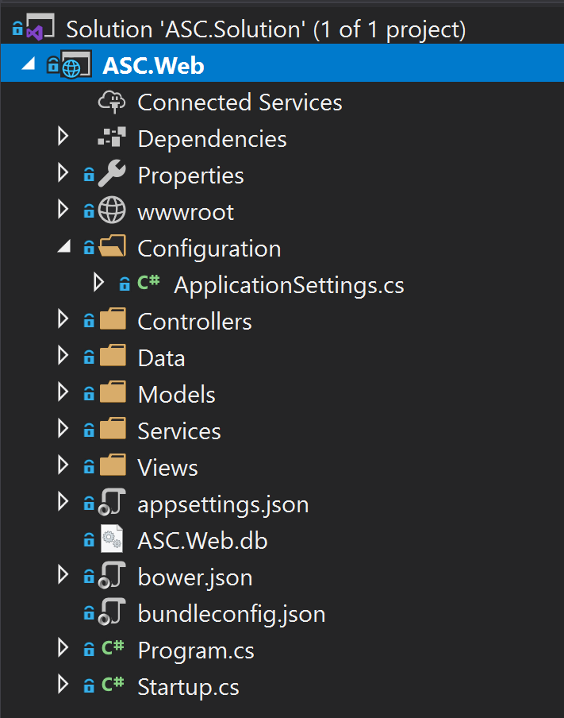
Configuration Folder and File
Right-click the ASC.Web (blue highlighted section in the picture) to add a new folder and file.
The Add menu item will have both folders and class menu items for the folder and file creation, respectively.

Slide 18
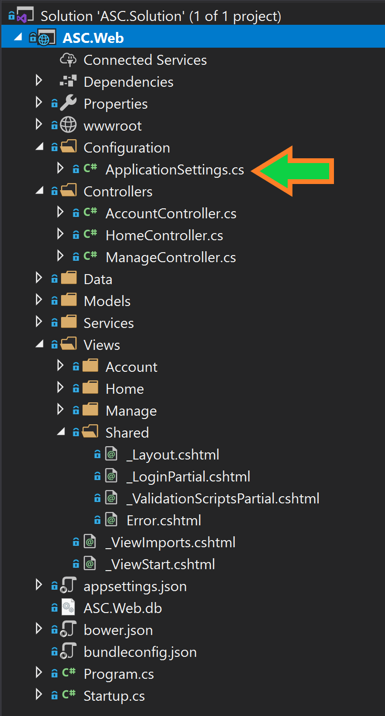
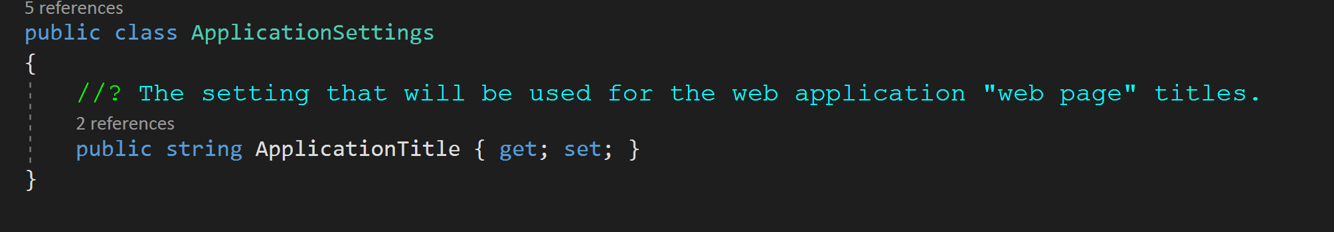
ApplicationSettngs.cs
Listing 2.4:

Slide 19
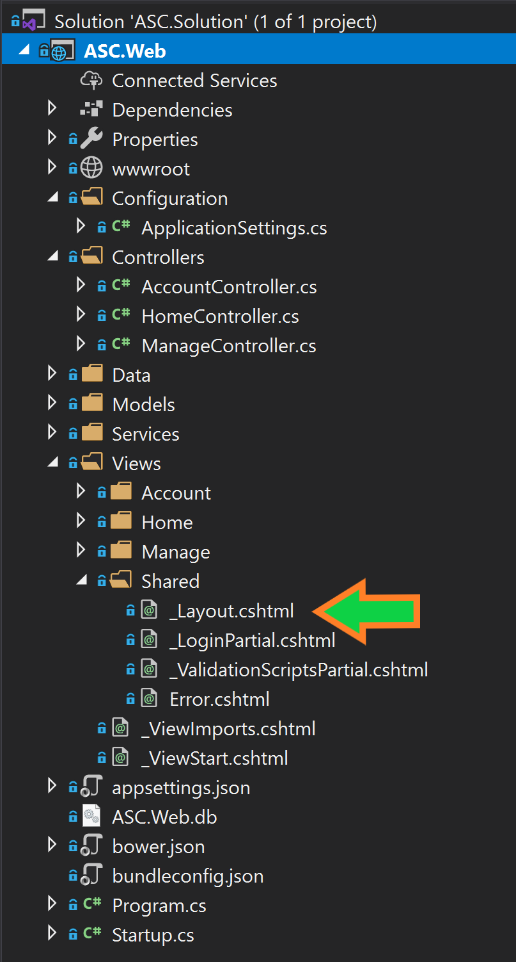
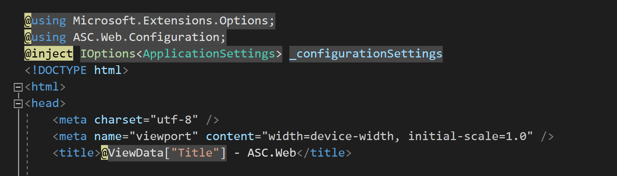
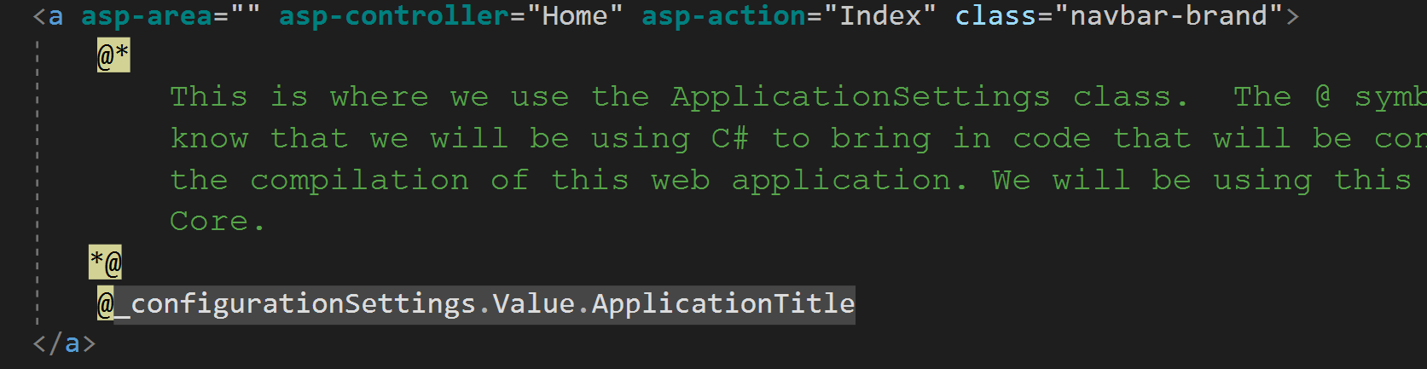
_layout.cshtml
Listing 2.6:
Listing 2.7:

Slide 20
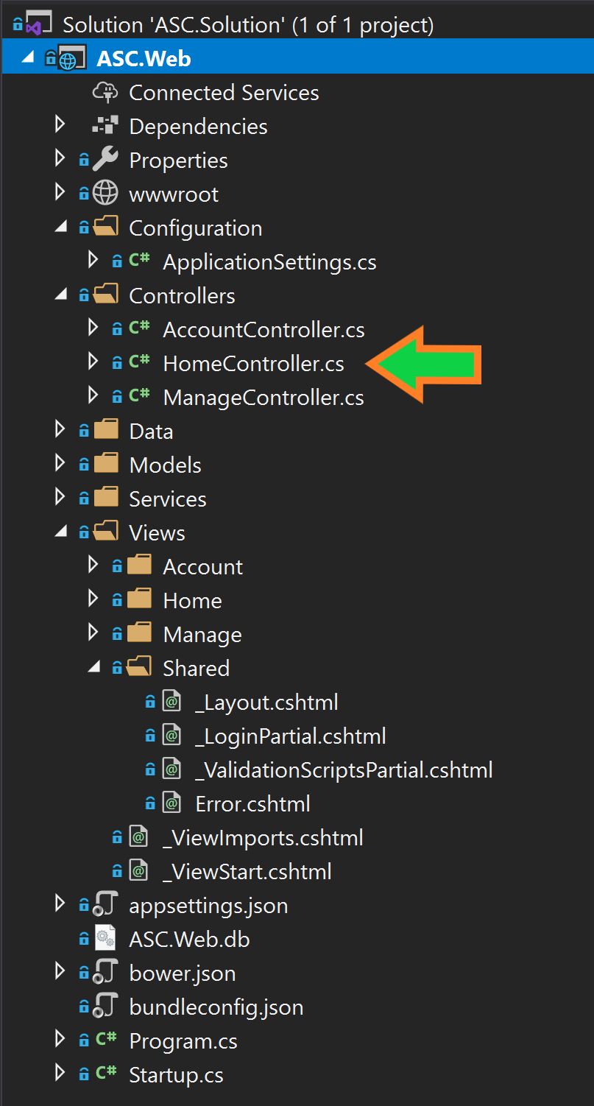
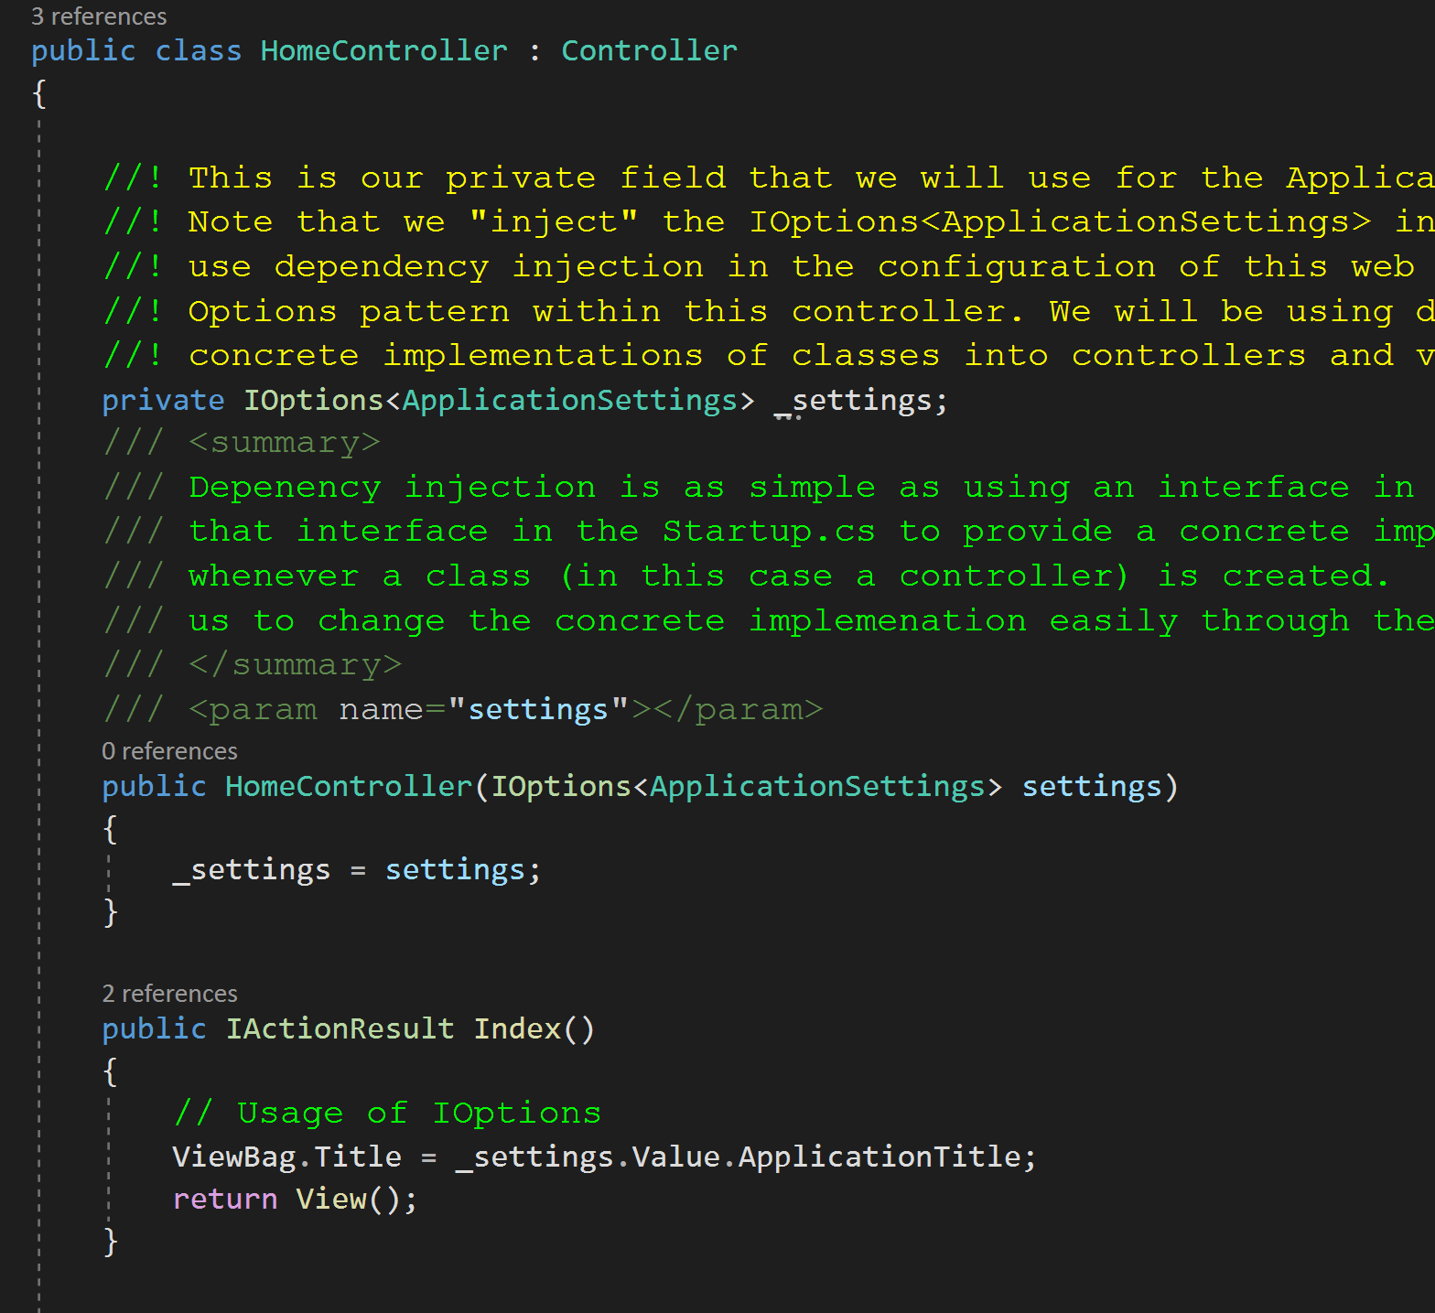
HomeController.cs
Listing 2.8:

Slide 21
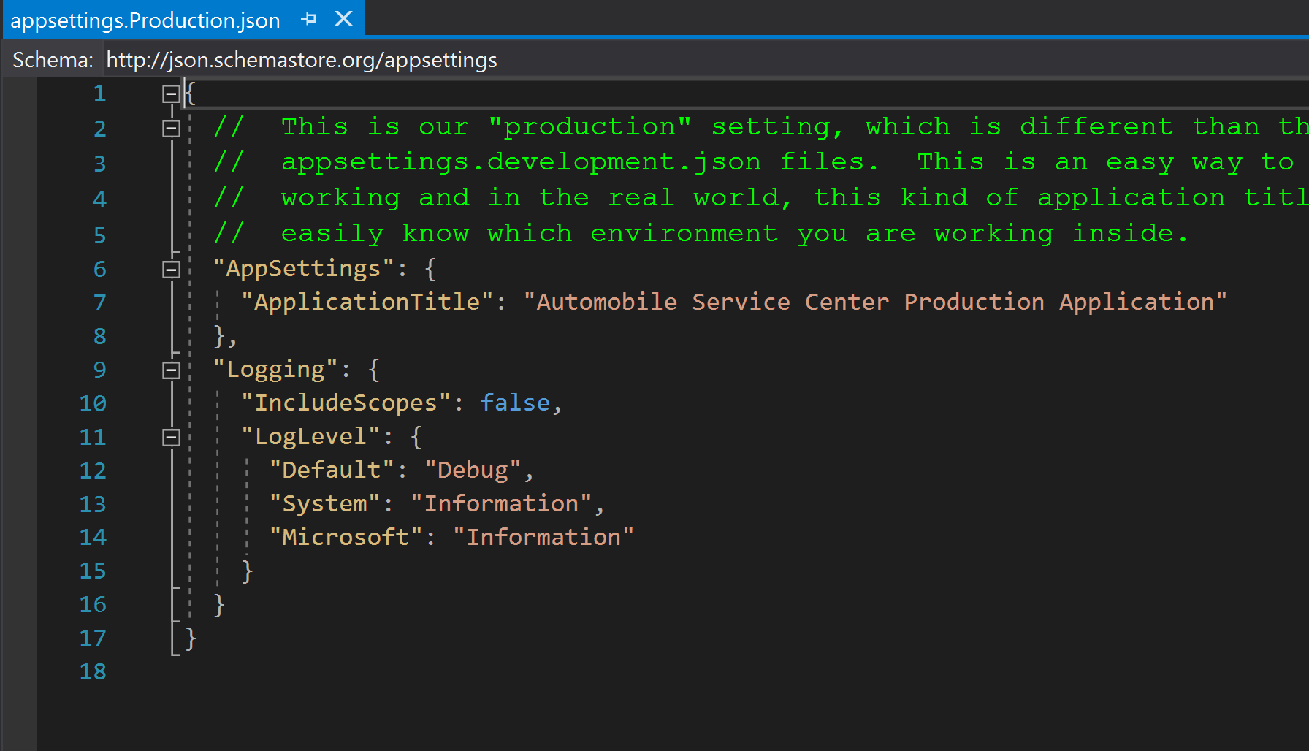
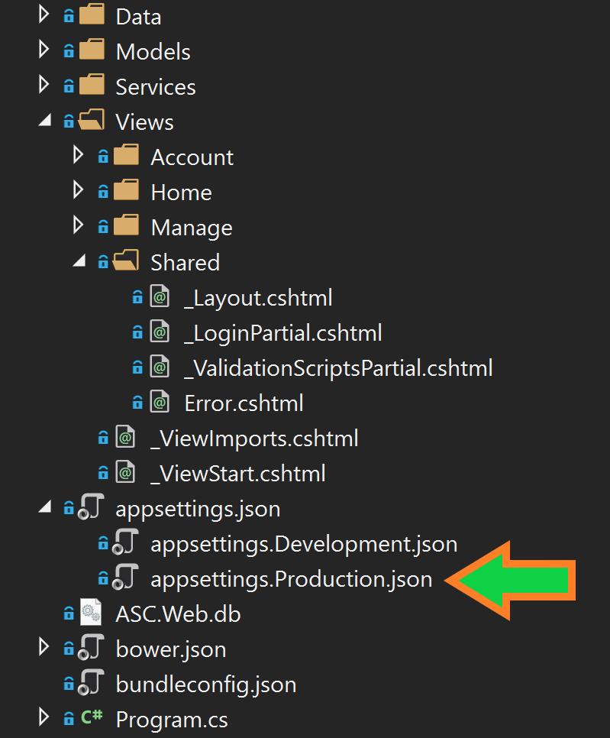
Appsettings.production.json
Listing 2.9:
You will have to create this file.

Slide 22
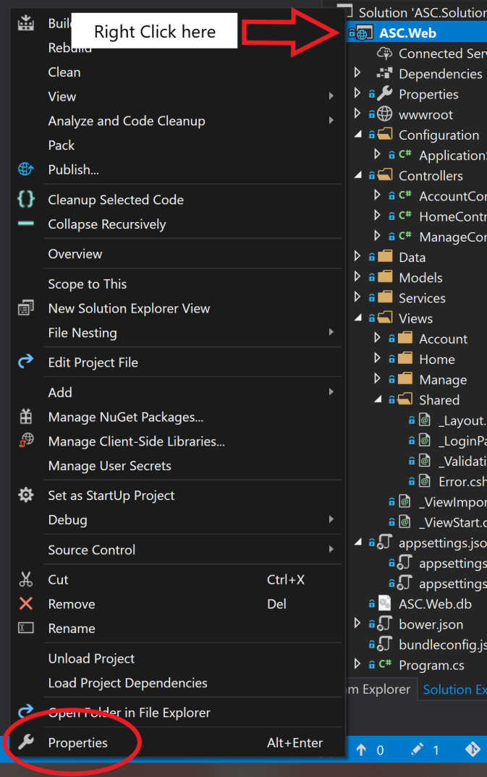
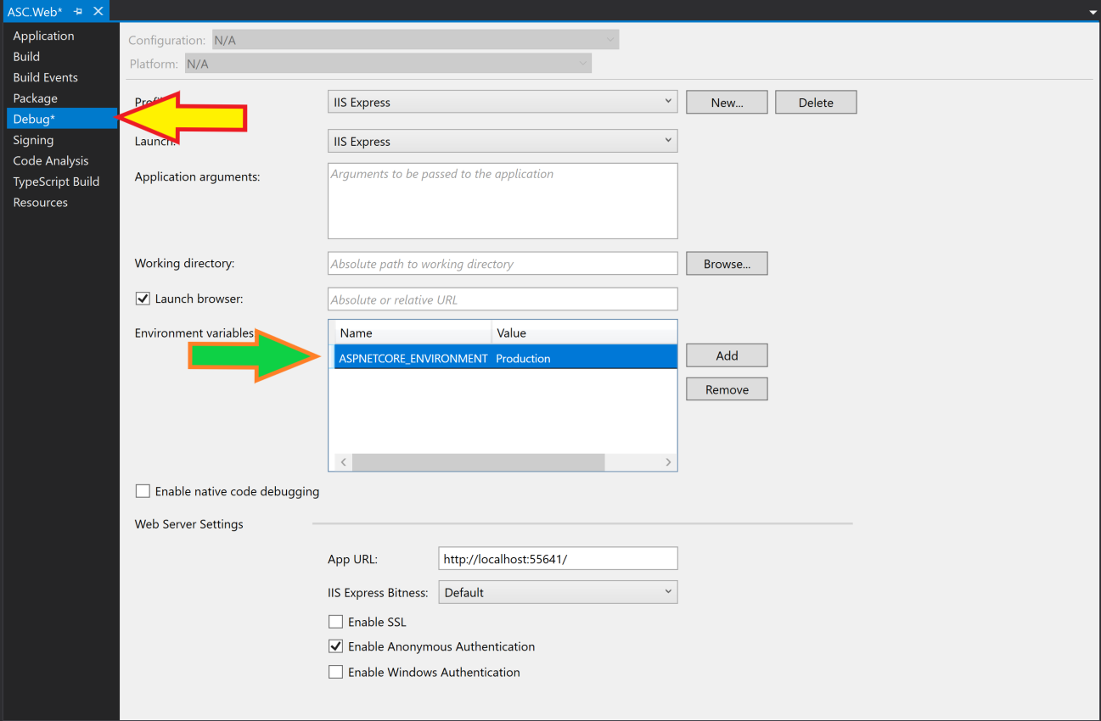
Project Properties
Listing 2.17:

Slide 23
Final notes (Dependency injection)
There is one last section on “Dependency Injection” that this PowerPoint will not have additional notes to cover as there is no “code work” to do. This is an informative block of text that I ask you all to read carefully and find the code in the web application. This will help you learn a little bit about dependency injection now, as we will be using it extensively as the class progresses.

